Slide 1
Neural Semiconductor Limited
<HTML>
Presented By : <Nibaron Kumar Das>
<Trainee Software Engineer>
Neural Semiconductor Limited

Slide 2
What is HTML?
HTML stands for Hyper Text Markup Language.
HTML is the building block of a Web page.
HTML elements tell the browser how to display the content.

Slide 3
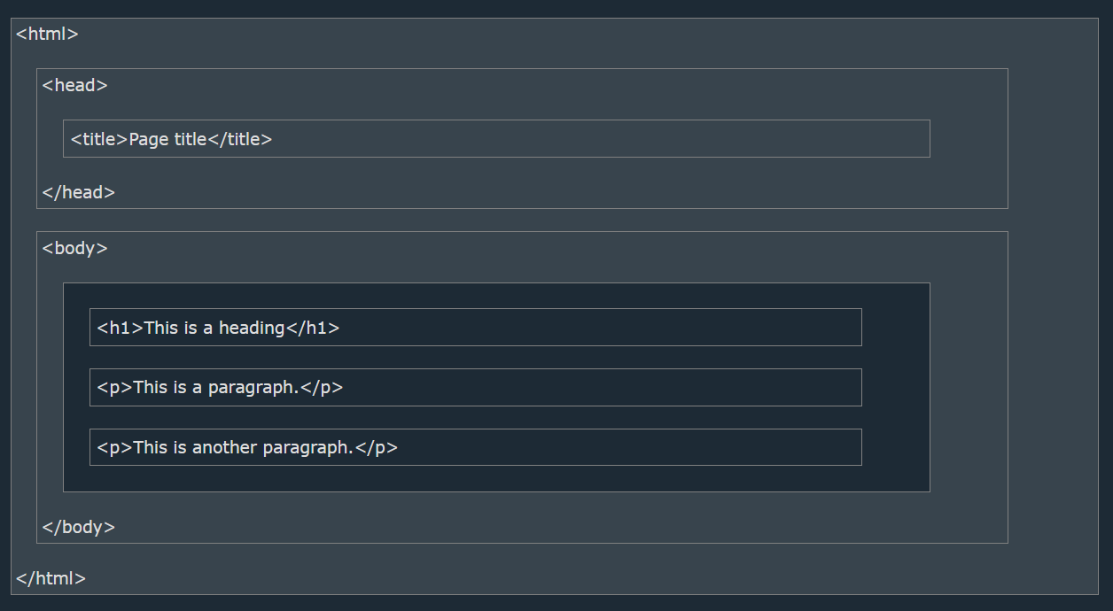
Basic Structure of HTML

Slide 4
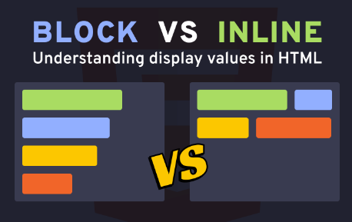
A block-level element always starts on a new line and takes up the full width available.
An inline element does not start on a new line, and it only takes up as much width as necessary.
<table>
<span>
<img>
<section>
<input>
<button>
<form>
<div>

Slide 5
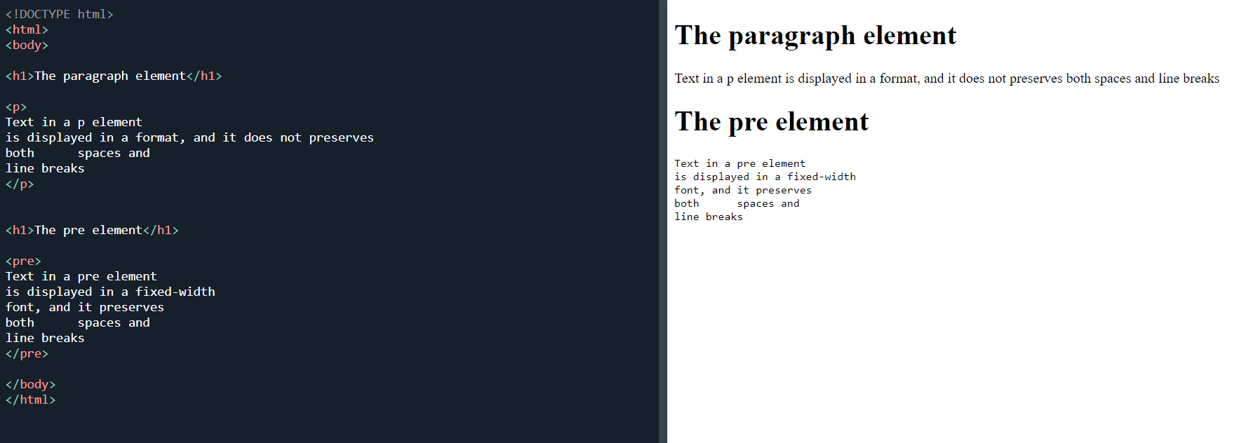
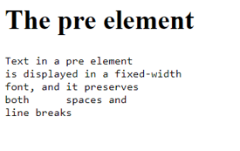
The Poem Problem

Slide 6
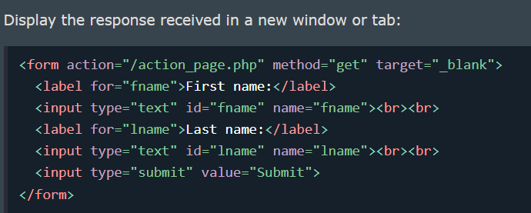
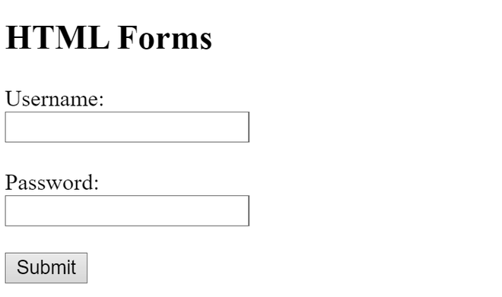
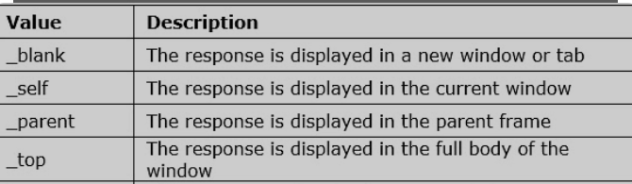
FORM TARGET
<HTML>

Slide 7

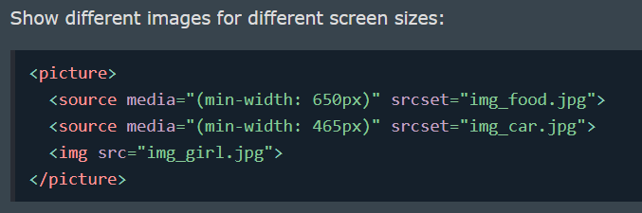
Image and Picture Element
<img> tag is not enough.
The HTML <picture> element allows you to display different pictures for different devices or screen sizes.

Slide 8
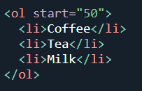
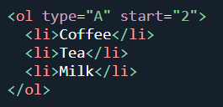
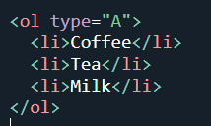
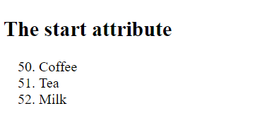
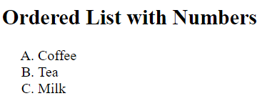

List Attribute
Type Start

Slide 9
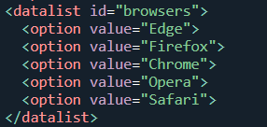
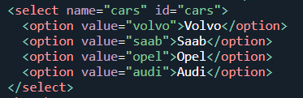
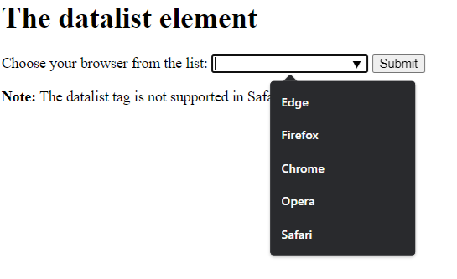
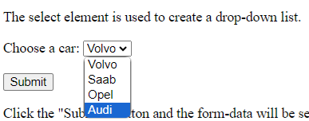
Data List and Select
Use <datalist> when you want to provide suggestions but still allow users to input custom values.
Use <select> when you want to limit the user's choices strictly to the options you provide.

Slide 10
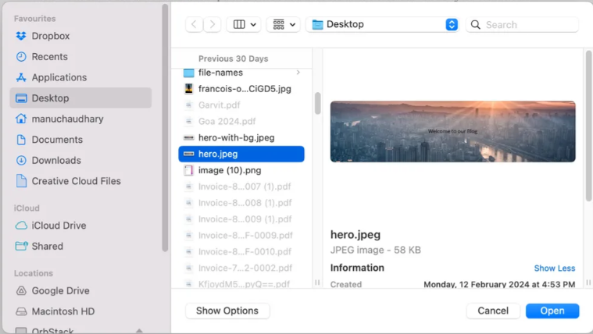

Media Files
The foundation of file uploading in HTML lies in the <input type="file"> element.
To restrict the types of files users can select, use the accept attribute.
You can specify multiple types:
Figure: only accept images

Slide 11
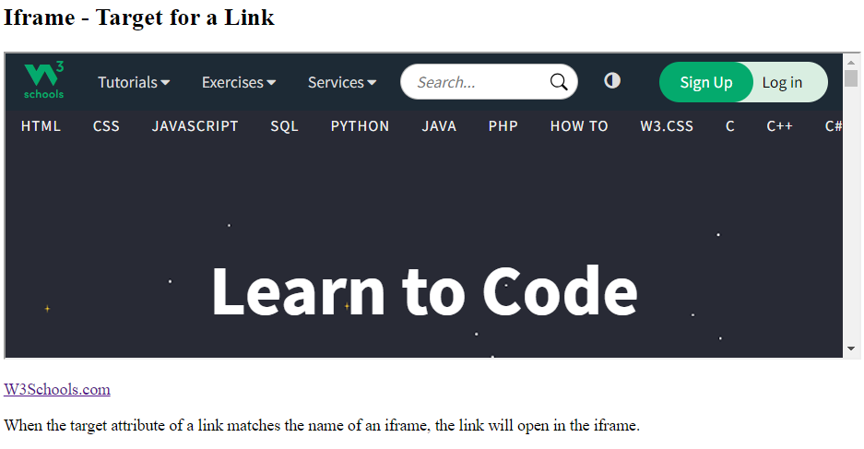
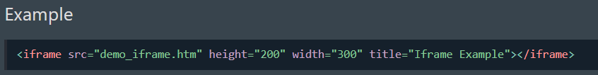

<iframe>
An inline frame is used to embed another document within
the current HTML document.
Iframe Target for a link
You can set a target frame for a link by using iframe.
Your specified target attribute of the link must refer to the name attribute of the iframe

Slide 12
Good Practice
1. Use Proper Document Structure and a Meaningful
Title and Descriptive Meta Tags.
2. Close your tag and Write Tags in Lowercase.
3. Add Image Attributes( alt)
4. Avoid Using Inline Styles.
5. Use Heading Elements Wisely.

Slide 13

Any Questions?

Slide 14
Thank You
info@neural-semiconductor.com

